Slide 1
Data Link Control

Slide 2
11-1 FRAMING
The data link layer needs to pack bits into frames, so that each frame is distinguishable from another. Our postal system practices a type of framing. The simple act of inserting a letter into an envelope separates one piece of information from another; the envelope serves as the delimiter.
Topics discussed in this section:
Fixed-Size Framing
Variable-Size Framing
11.<number>

Slide 3
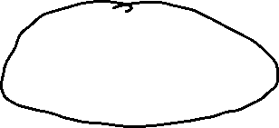



Figure 11.1 A frame in a character-oriented protocol
11.<number>

Slide 4


Figure 11.2 Byte stuffing and unstuffing
11.<number>

Slide 5

Note
Byte stuffing is the process of adding 1 extra byte whenever there is a flag or escape character in the text.
11.<number>

Slide 6


Figure 11.3 A frame in a bit-oriented protocol
11.<number>

Slide 7
Note
Bit stuffing is the process of adding one extra 0 if 011111 is encountered in data, so that the receiver does not mistake
the pattern 0111110 for a flag.
11.<number>

Slide 8



Figure 11.4 Bit stuffing and unstuffing
11.<number>

Slide 9


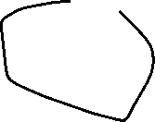







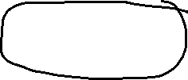

11-2 FLOW AND ERROR CONTROL
The most important responsibilities of the data link layer are flow control and error control. Collectively, these functions are known as data link control.
Topics discussed in this section:
Flow Control
Error Control
11.<number>

Slide 10
Note
Flow control refers to a set of procedures used to restrict the amount of data
that the sender can send before
waiting for acknowledgment.
Aka: Don’t overwhelm the receiver!
11.<number>

Slide 11
Note
Error control in the data link layer is based on automatic repeat request, which is the retransmission of data.
11.<number>

Slide 12


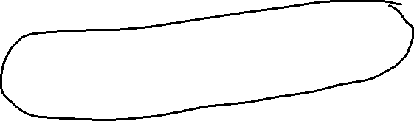






11-3 PROTOCOLS
Now let us see how the data link layer can combine framing, flow control, and error control to achieve the delivery of data from one node to another.
11.<number>

Slide 13






Figure 11.5 Taxonomy of protocols discussed in this chapter
11.<number>

Slide 14
11-4 NOISELESS CHANNELS
Let us first assume we have an ideal channel in which no frames are lost, duplicated, or corrupted. We introduce two protocols for this type of channel.
Topics discussed in this section:
Simplest Protocol
Stop-and-Wait Protocol
11.<number>

Slide 15
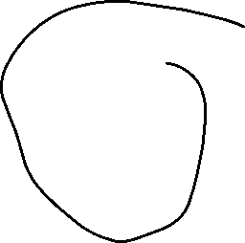

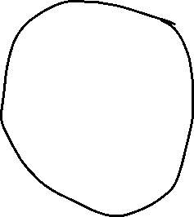








Figure 11.6 The design of the simplest protocol with no flow or error control
11.<number>

Slide 16




Figure 11.7 Flow diagram for Example 11.1
11.<number>

Slide 17
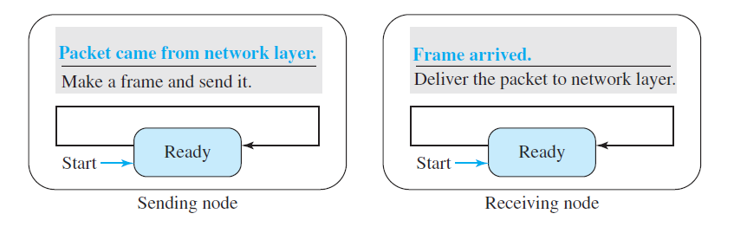
Finite State Machine (FSM) Diagram
11.<number>

Slide 18
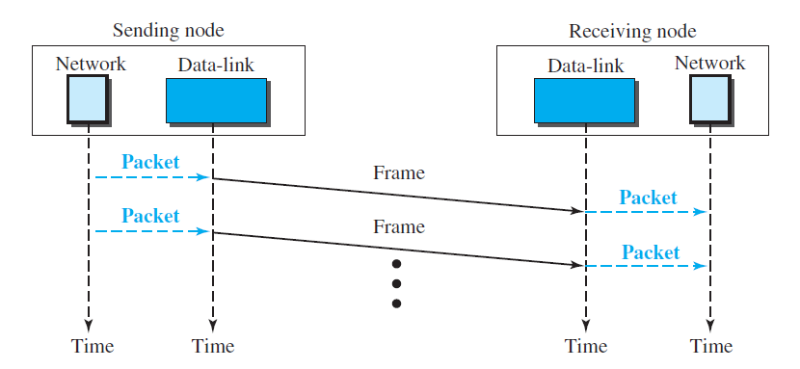
Flow Diagram
11.<number>

Slide 19
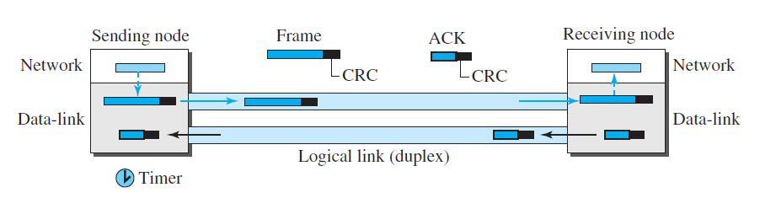

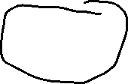
Stop-and-Wait Protocol
11.<number>

Slide 20



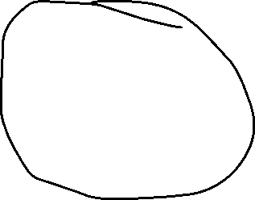
Figure 11.8 Design of Stop-and-Wait Protocol
11.<number>

Slide 21

Figure 11.9 Flow diagram for Example 11.2
11.<number>

Slide 22
11-5 NOISY CHANNELS
Although the Stop-and-Wait Protocol gives us an idea of how to add flow control to its predecessor, noiseless channels are nonexistent. We discuss three protocols in this section that use error control.
Topics discussed in this section:
Stop-and-Wait Automatic Repeat Request
Go-Back-N Automatic Repeat Request
Selective Repeat Automatic Repeat Request
11.<number>

Slide 23
Note
Error correction in Stop-and-Wait ARQ is done by keeping a copy of the sent frame and retransmitting of the frame when the timer expires.
11.<number>

Slide 24
Note
In Stop-and-Wait ARQ, we use sequence numbers to number the frames.
The sequence numbers are based on modulo-2 arithmetic.
11.<number>

Slide 25
Note
In Stop-and-Wait ARQ, the acknowledgment number always announces in modulo-2 arithmetic the sequence number of the next frame expected.
11.<number>

Slide 26


Figure 11.10 Design of the Stop-and-Wait ARQ Protocol
11.<number>

Slide 27
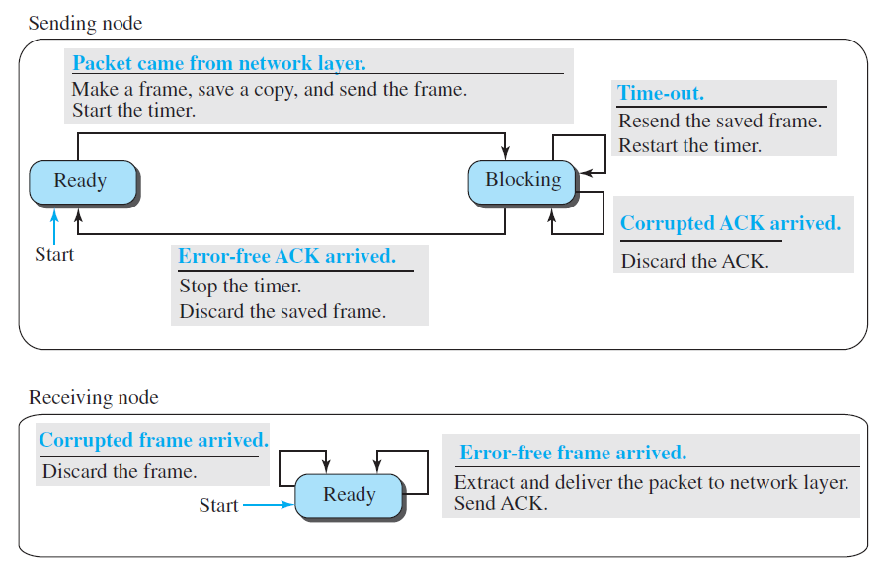
Finite State Machine (FSM) Diagram
11.<number>

Slide 28
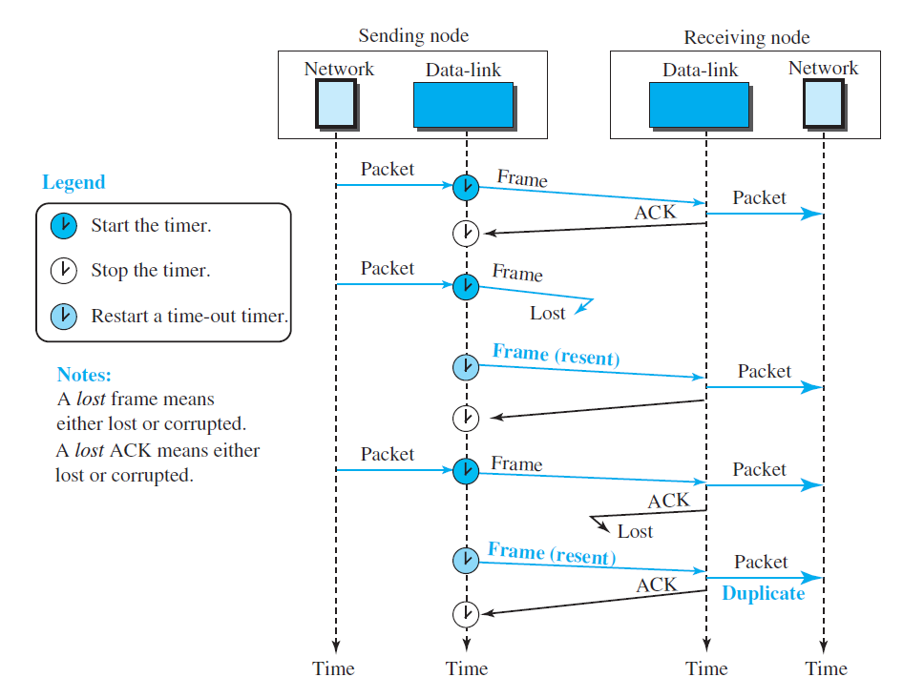










11.<number>

Slide 29
Example 11.3
Figure 11.11 shows an example of Stop-and-Wait ARQ. Frame 0 is sent and acknowledged. Frame 1 is lost and resent after the time-out. The resent frame 1 is acknowledged and the timer stops. Frame 0 is sent and acknowledged, but the acknowledgment is lost. The sender has no idea if the frame or the acknowledgment is lost, so after the time-out, it resends frame 0, which is acknowledged.
11.<number>

Slide 30

Figure 11.11 Flow diagram for Example 11.3
11.<number>

Slide 31
Example 11.4
Assume that, in a Stop-and-Wait ARQ system, the bandwidth of the line is 1 Mbps, and 1 bit takes 20 ms to make a round trip. What is the bandwidth-delay product? If the system data frames are 1000 bits in length, what is the utilization percentage of the link?
Solution
The bandwidth-delay product is
11.<number>

Slide 32
Example 11.4 (continued)
The system can send 20,000 bits during the time it takes for the data to go from the sender to the receiver and then back again. However, the system sends only 1000 bits. We can say that the link utilization is only 1000/20,000, or 5 percent. For this reason, for a link with a high bandwidth or long delay, the use of Stop-and-Wait ARQ wastes the capacity of the link.
11.<number>

Slide 33
Example 11.5
What is the utilization percentage of the link in Example 11.4 if we have a protocol that can send up to 15 frames before stopping and worrying about the acknowledgments?
Solution
The bandwidth-delay product is still 20,000 bits. The system can send up to 15 frames or 15,000 bits during a round trip. This means the utilization is 15,000/20,000, or 75 percent. Of course, if there are damaged frames, the utilization percentage is much less because frames have to be resent.
11.<number>

Slide 34
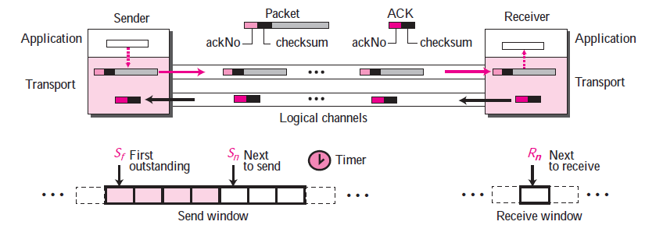


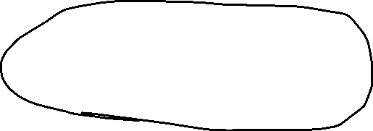





Go-Back-N Protocol
11.<number>

Slide 35
Note
In the Go-Back-N Protocol, the sequence numbers are modulo 2^{m},
where m is the size of the sequence number field in bits.
11.<number>

Slide 36






Figure 11.12 Send window for Go-Back-N ARQ
11.<number>

Slide 37
Note
The send window is an abstract concept defining an imaginary box of size 2^{m} − 1 with three variables: Sf, Sn, and S_{size}.
11.<number>

Slide 38
Note
The send window can slide one
or more slots when a valid acknowledgment arrives.
11.<number>

Slide 39



Figure 11.13 Receive window for Go-Back-N ARQ
11.<number>

Slide 40
Note
The receive window is an abstract concept defining an imaginary box
of size 1 with one single variable R_{n}.
The window slides
when a correct frame has arrived; sliding occurs one slot at a time.
11.<number>

Slide 41
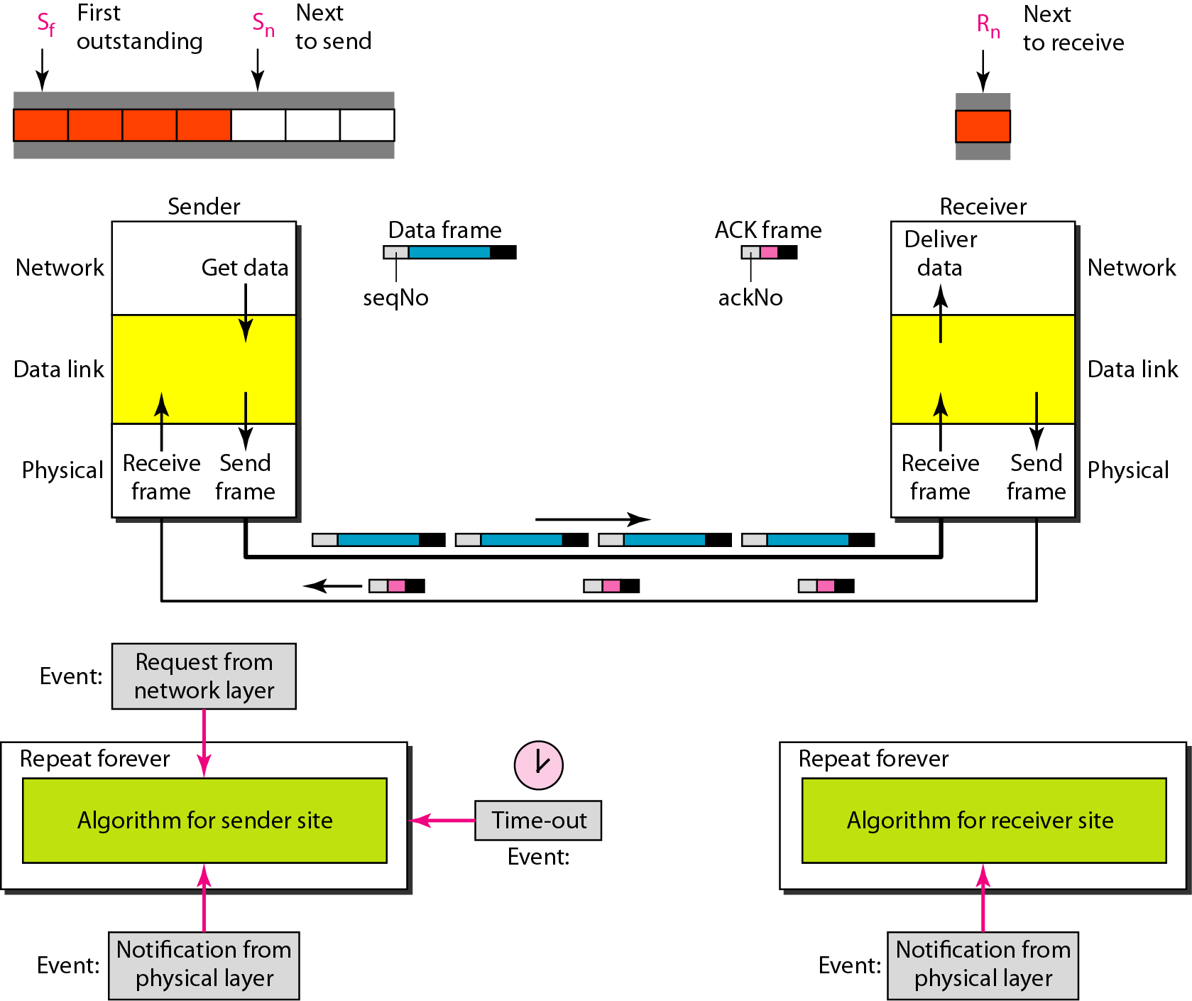
Figure 11.14 Design of Go-Back-N ARQ
11.<number>

Slide 42






Figure 11.15 Window size for Go-Back-N ARQ
11.<number>

Slide 43
Note
In Go-Back-N ARQ, the size of the send window must be less than 2^{m};
the size of the receiver window
is always 1.
11.<number>

Slide 44
Example 11.6
Figure 11.16 shows an example of Go-Back-N. This is an example of a case where the forward channel is reliable, but the reverse is not. No data frames are lost, but some ACKs are delayed and one is lost. The example also shows how cumulative acknowledgments can help if acknowledgments are delayed or lost. After initialization, there are seven sender events. Request events are triggered by data from the network layer; arrival events are triggered by acknowledgments from the physical layer. There is no time-out event here because all outstanding frames are acknowledged before the timer expires. Note that although ACK 2 is lost, ACK 3 serves as both ACK 2 and ACK 3.
11.<number>

Slide 45

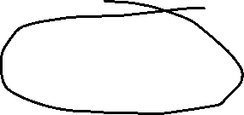


Figure 11.16 Flow diagram for Example 11.6
11.<number>

Slide 46
Example 11.7
Figure 11.17 shows what happens when a frame is lost. Frames 0, 1, 2, and 3 are sent. However, frame 1 is lost. The receiver receives frames 2 and 3, but they are discarded because they are received out of order. The sender receives no acknowledgment about frames 1, 2, or 3. Its timer finally expires. The sender sends all outstanding frames (1, 2, and 3) because it does not know what is wrong. Note that the resending of frames 1, 2, and 3 is the response to one single event. When the sender is responding to this event, it cannot accept the triggering of other events. This means that when ACK 2 arrives, the sender is still busy with sending frame 3.
11.<number>

Slide 47
Example 11.7 (continued)
The physical layer must wait until this event is completed and the data link layer goes back to its sleeping state. We have shown a vertical line to indicate the delay. It is the same story with ACK 3; but when ACK 3 arrives, the sender is busy responding to ACK 2. It happens again when ACK 4 arrives. Note that before the second timer expires, all outstanding frames have been sent and the timer is stopped.
11.<number>

Slide 48

Figure 11.17 Flow diagram for Example 11.7
11.<number>

Slide 49
Note
Stop-and-Wait ARQ is a special case of Go-Back-N ARQ in which the size of the send window is 1.
11.<number>

Slide 50




Figure 11.18 Send window for Selective Repeat ARQ
11.<number>

Slide 51


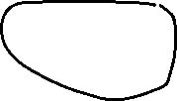
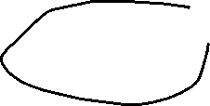
Figure 11.19 Receive window for Selective Repeat ARQ
11.<number>

Slide 52
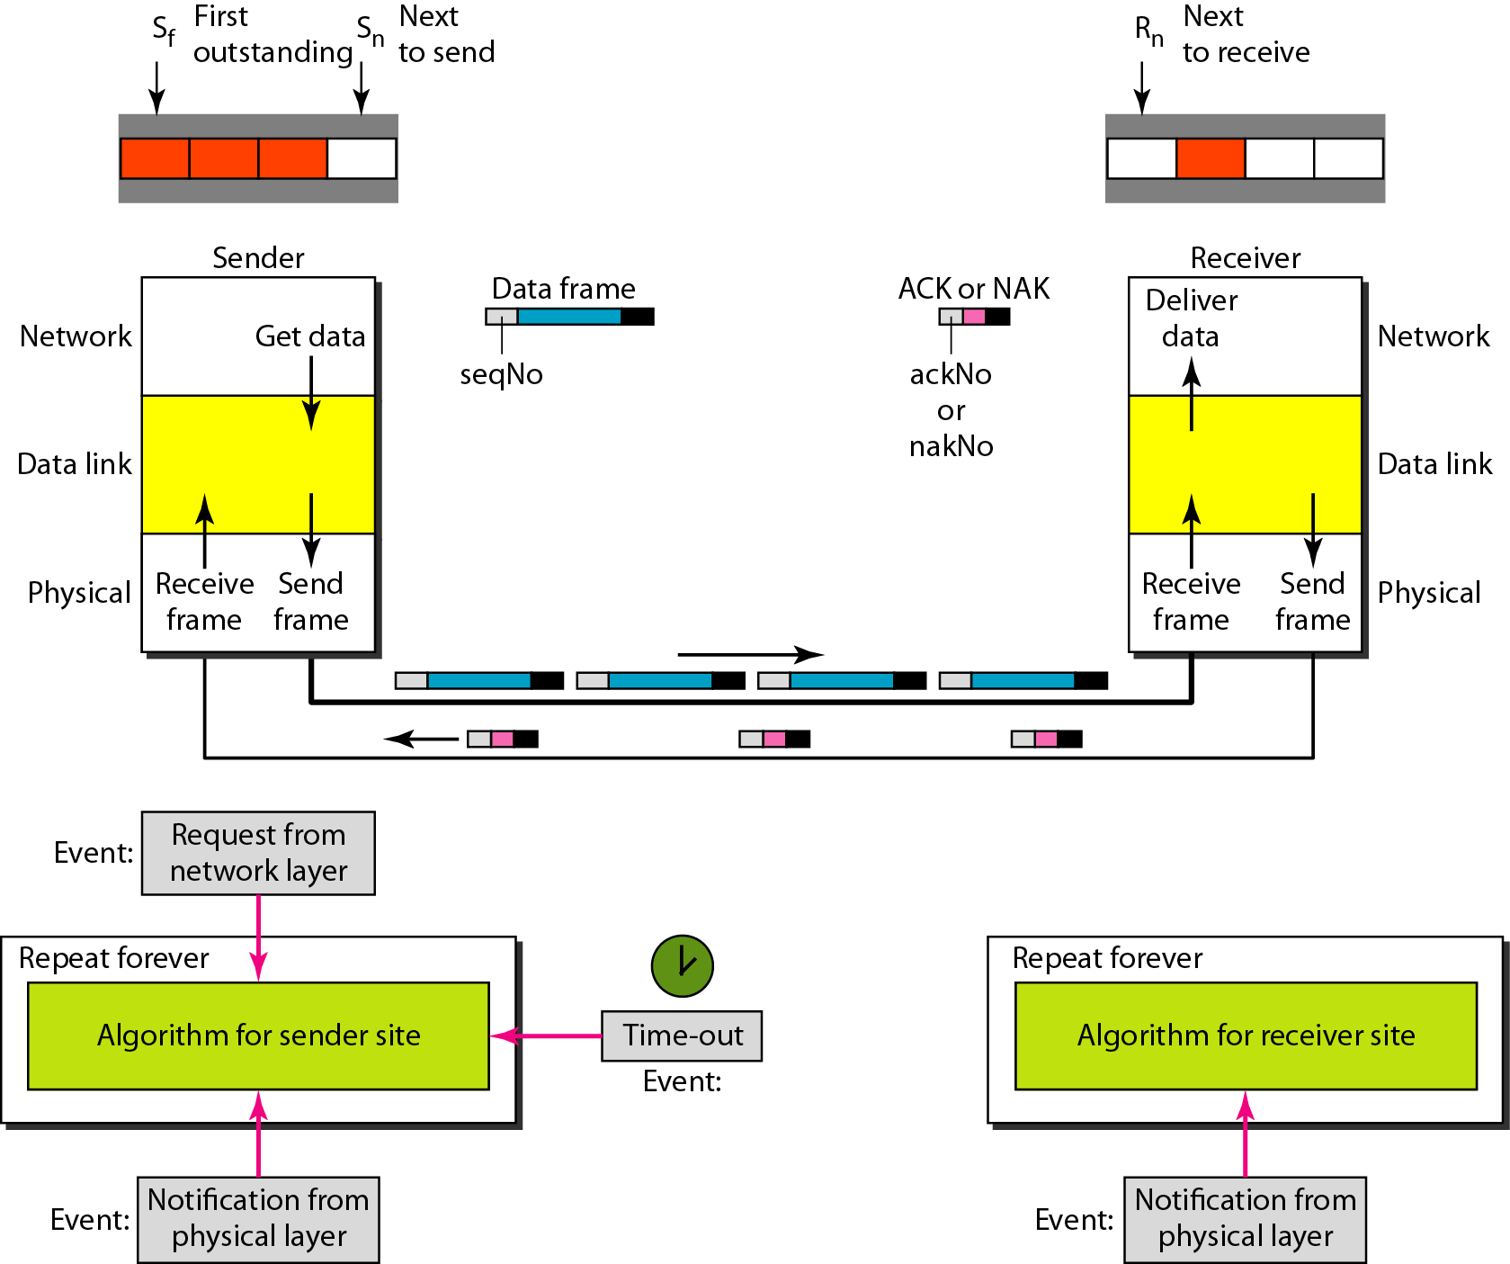
Figure 11.20 Design of Selective Repeat ARQ
11.<number>

Slide 53
Note
In Selective Repeat ARQ, the size of the sender and receiver window
must be at most one-half of 2^{m}.
11.<number>

Slide 54


Figure 11.22 Delivery of data in Selective Repeat ARQ
11.<number>

Slide 55
Example 11.8
This example is similar to Example 11.3 in which frame 1 is lost. We show how Selective Repeat behaves in this case. Figure 11.23 shows the situation. One main difference is the number of timers. Here, each frame sent or resent needs a timer, which means that the timers need to be numbered (0, 1, 2, and 3). The timer for frame 0 starts at the first request, but stops when the ACK for this frame arrives. The timer for frame 1 starts at the second request, restarts when a NAK arrives, and finally stops when the last ACK arrives. The other two timers start when the corresponding frames are sent and stop at the last arrival event.
11.<number>

Slide 56
Example 11.8 (continued)
At the receiver site we need to distinguish between the acceptance of a frame and its delivery to the network layer. At the second arrival, frame 2 arrives and is stored and marked, but it cannot be delivered because frame 1 is missing. At the next arrival, frame 3 arrives and is marked and stored, but still none of the frames can be delivered. Only at the last arrival, when finally a copy of frame 1 arrives, can frames 1, 2, and 3 be delivered to the network layer. There are two conditions for the delivery of frames to the network layer: First, a set of consecutive frames must have arrived. Second, the set starts from the beginning of the window.
11.<number>

Slide 57
Example 11.8 (continued)
Another important point is that a NAK is sent after the second arrival, but not after the third, although both situations look the same. The reason is that the protocol does not want to crowd the network with unnecessary NAKs and unnecessary resent frames. The second NAK would still be NAK1 to inform the sender to resend frame 1 again; this has already been done. The first NAK sent is remembered (using the nakSent variable) and is not sent again until the frame slides. A NAK is sent once for each window position and defines the first slot in the window.
11.<number>

Slide 58
Example 11.8 (continued)
The next point is about the ACKs. Notice that only two ACKs are sent here. The first one acknowledges only the first frame; the second one acknowledges three frames. In Selective Repeat, ACKs are sent when data are delivered to the network layer. If the data belonging to n frames are delivered in one shot, only one ACK is sent for all of them.
11.<number>

Slide 59







Figure 11.23 Flow diagram for Example 11.8
11.<number>

Slide 60
Piggybacking
To make the communication more efficient, the data in one direction is piggybacked with the acknowledgement in the other direction.
11.<number>

